Slide 1
General guide for assessing immunizations among refugees
Lynn Bahta, RN, PHN
Immunization Clinical Consultant

Slide 2
Objectives
Discuss principles used to guide catch-up immunizations among persons with insufficient immunization records.
Describe key tools that are used to assess immunization rates among refugees and immigrants with incomplete or no records.
Highlight recent updates and alerts related to immunization among refugees and immigrants.

Slide 3
Health Status of New Refugees, Minnesota Immunization Status, 2002 – 2015
Source: MDH Refugee Health Program, November 2016

Slide 4
General concepts
We follow national recommendations approved by the Advisory Committee on Immunization Practices (ACIP)
Give all recommended vaccines
Critical opportunity to vaccinate

Slide 5
General concepts
Documentation of overseas vaccination count
Age of first dose is important
Intervals between doses are important
Except indistinct polio vaccination given 04-2016 or later

Slide 6
General concepts
If there is no documentation, it cannot be counted
“I’m up-to-date,” or “I had all the recommended vaccines” has a different meaning for every individual
Additional doses of vaccines are generally safe

Slide 7
Guide to immunization assessment
Determine age
Review medical history and records
Determine the vaccine needs
Assess contraindications and precautions
Assess laboratory needs
Taken from 2009 Technical Instructions for Vaccination for Civil Surgeons at http://www.cdc.gov/immigrantrefugeehealth/exams/ti/civil/vaccination-civil-technical-instructions.html#assessment

Slide 8
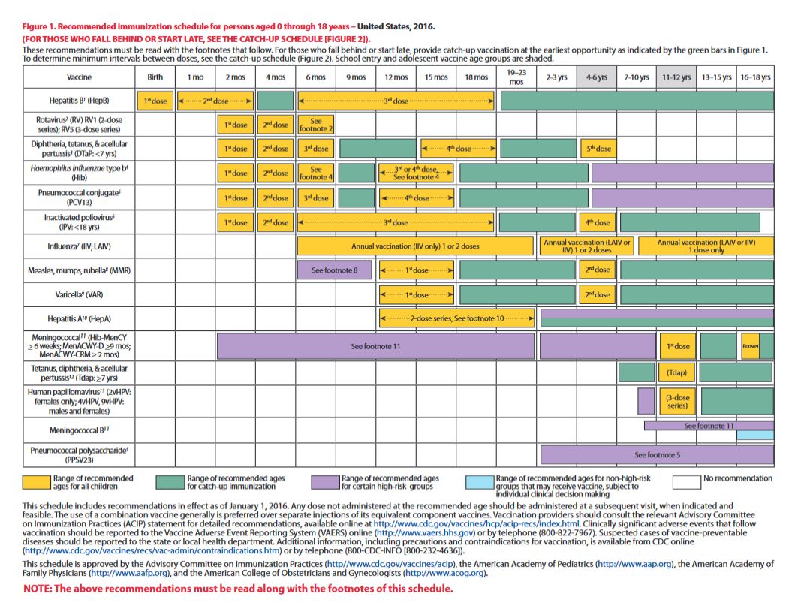
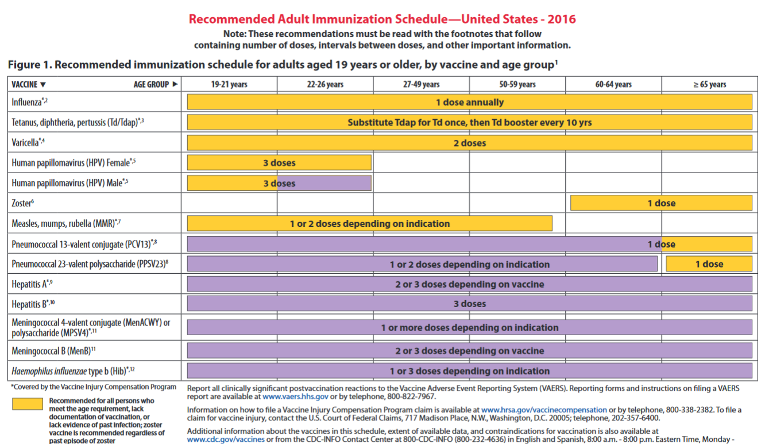
Tools for assessing immunizations
http://www.cdc.gov/vaccines/schedules/hcp/index.html

Slide 9
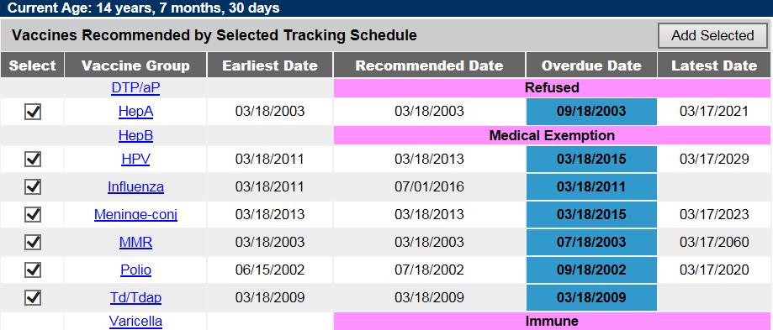
Tools for assessing immunizations

Slide 11
Tetanus, diphtheria and pertussis
Recommended: Age-appropriate vaccination
Alternative option: tetanus and diphtheria titers; no test for pertussis

Slide 12
Hepatitis B
Recommended: Age-appropriate re-vaccination; HBsAg test to determine disease status among refugees from areas of intermediate and high disease prevalence
Vaccinate persons that are not immune
Alternative option: none

Slide 13
Hib
Recommended: Age-appropriate vaccination
Alternative option: none

Slide 14
Rotavirus
Recommended: Age-appropriate vaccination, observe maximum age to start and complete series
Alternative option: none

Slide 15
Varicella
Recommended: age-appropriate vaccination

Slide 16
Measles, Mumps, Rubella
Recommended: Age-appropriate vaccination
Alternative option: serology for all three must be positive, otherwise MMR needs to be administered

Slide 17
Polio
Recommended: Vaccinate to age 18 years
Alternative option: None
New guidance: OPV without distinct trivalent (tOPV) documentation can no longer be accepted if dose given April 2016 or later

Slide 19
If necessary, when could serology be an option?
Vaccine | Alternative approach | Recommendation | Repeat dose concerns?*
Diphtheria, tetanus, pertussis | Only for diphtheria and tetanus; not for pertussis | Vaccinate: DTaP (2 m through 6 yrs); Tdap/Td (7 years & older) | Increased swelling at injection site
MMR | Yes; must be immune to all three diseases | Document immunity or vaccinate. | No.
Hib | No | Vaccinate as age appropriate to age 5 years | No
Polio | No | Give IPV | No
Pneumococcal | No | Vaccinate as age appropriate to age 5 yrs; if at risk; 65 years and older | Increased risk of local reaction
Varicella | Yes | Document immunity or vaccinate | No
Hepatitis B | Yes | HBsAg - persons from areas of intermediate and high endemicity; vaccinate if serology shows person not immune | No
Hepatitis A | Yes; children 12-23 months | Vaccinate, if tested document immunity | No
Meningococcal | No | Vaccinate | Increased risk of local reaction
HPV | No | Vaccinate | No
Zoster | No | Vaccinate | No
*Does not include common side effects that can be seen with any dose of that vaccine

Slide 20
https://www.cdc.gov/vaccines/hcp/acip-recs/general-recs/downloads/general-recs.pdf

Slide 21
Thank You
Lynn Bahta, RN, PHN
Immunization Clinical Consultant
Lynn.bahta@state.mn.us

