Slide 1
School-Located Immunization Clinics in Fillmore County
Paula Melver, RN
Brenda Leigh Pohlman, BS, MPH, Health Educator
507-765-3898

Slide 2
Partners
Fillmore County Public Health
Local Clinics (6)
Chatfield School District
Fillmore-Central School District
Kingsland School District
Lanesboro School District
Mabel-Canton School District
Rushford-Peterson School District
St. John’s Lutheran Elementary School

Slide 3
School Immunization Clinic Model
Meningococcal Spring 2014
Influenza Fall 2015
Grades 6-12
Registration forms available in print and electronic formats
Media: PSA, KIMT TV, and Agrimson Case
Throughput: 1.25 People/Minute
6 Clinics + Make Up + Appointments
Strike Team: 3 Staff
MIIC Entry within 2 Days
Grades K-12
Registration forms available in electronic format
Media: PSA
Throughput: 2.13 People/Minute
6 Clinics + Appointments
Strike Team: 3 Staff and Student Nurses
MIIC Entry within 1 Day

Slide 4
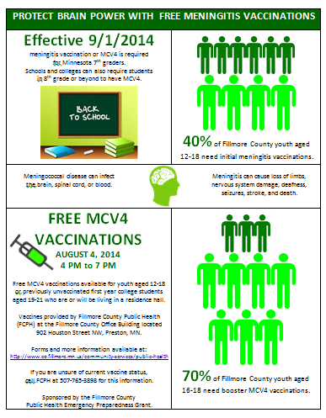
Operation Save My Brain 2014 MCV4 Vaccinations
Vaccine % Ordered = 40%
Vaccine Supply = 680
Vaccinated = 442
Results: Increase from 38% to 62% for first dose MCV4 vaccinations among 10 to 18 year olds and an increase from 16% to 33% for MCV4 booster doses for youth over age 16

Slide 5
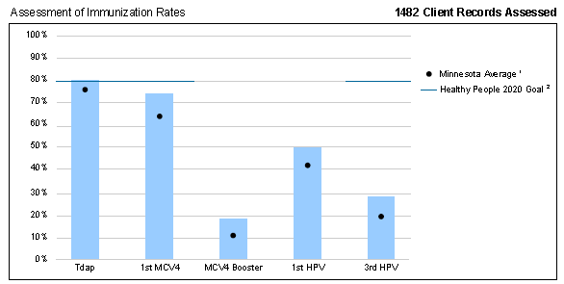
Current MCV4
1st MCV4 (7/23/2013): 38%
MCV4 Booster (7/23/2013): 16%
1st MCV4 (6/9/2014): 62%
MCV4 Booster (6/29/2014): 33%
1st MCV4 (8/4/2014): 63%
MCV4 Booster (8/4/2014): 35%
1st MCV4 (5/5/2016): 74%
MCV4 Booster (5/5/2016): 19%

Slide 6
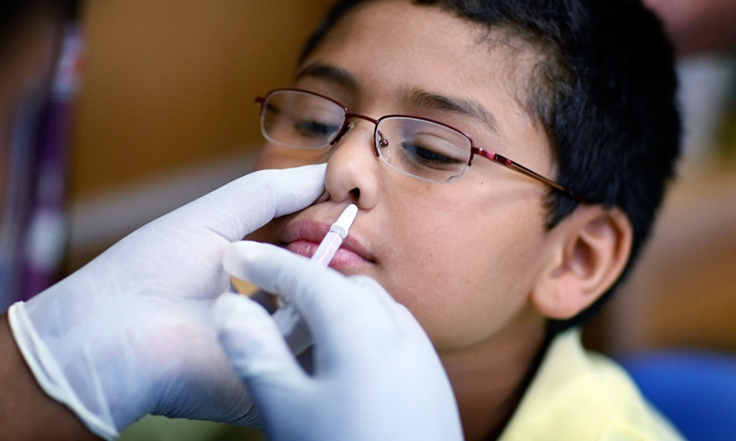
Operation No Flu For You 2015 Influenza Vaccinations
Vaccine % Ordered = 25%
Vaccine Supply = 720
Vaccinated = 728

Slide 7
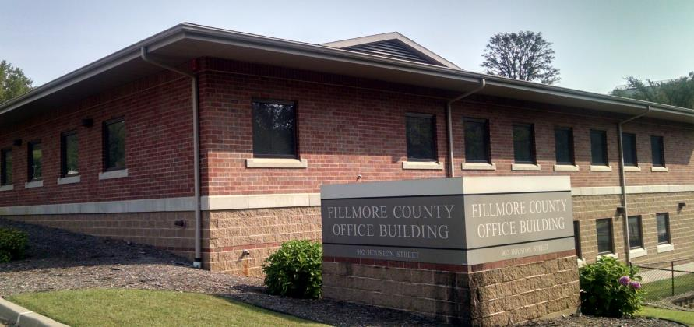
Best Practices
Ordering Supply
Transferring Supply
Communication
Prescreening
Media
MIIC Onsite Use
Student Nurses

