Slide 1
Practical Approaches to Reduce Pain and Discomfort with Vaccinations
Katy Bos, MS, APRN, PCNS-BC
Pediatric Clinical Nurse Specialist
Children's Center and Employee and Community Health-Pediatrics, Mayo Clinic
Copyright 2016 Mayo Foundation for Medical Education & Research

Slide 2
No financial disclosures

Slide 3
Objectives:
Describe why procedural pain control is important in children
Describe the current options for pain-relieving measures available for the pediatric population

Slide 4
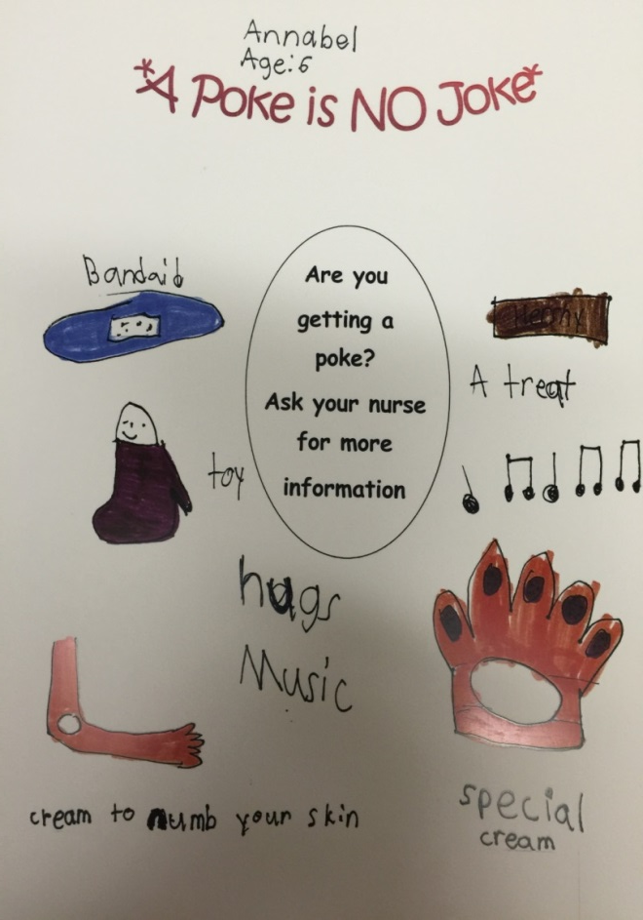
Pain relief makes a difference!
Mayo Clinic, 2015
Notes:
We cannot take away all the pain & distress associated with vaccinations, but we can certainly lessen them.
Goal is to give children ways and tools to better cope with vaccinations, medical procedures, and life.

Slide 5
Children consider needle pokes as one of the most frightening and painful health-related events, potentially leading to:
Health care avoidance behaviors (including immunization noncompliance) across the lifespan
Vaccine non-compliance which can potentially contribute to outbreaks or vaccine-preventable diseases
Fear of needles
(Chan, Pielak, Melntyre, Deeter, & Taddio, 2013; Taddio et al., 2015; WHO, 2015)

Slide 6
Importance of pain interventions
Recognized in the medical principle to
“first do no harm”
Pain relief is considered a basic human right
Pain and distress have a negative impact on the child’s level of cooperation and increase the need for physical restraint during pokes and procedures
Lack of pain management exposes children to unnecessary suffering
(Taddio, Chambers et al., 2009)

Slide 7
Interesting facts:
The most frequently reported painful events in a hospitalized child were IV starts and lab draws.
(Wong & Baker, 1988; Inal & Kelleci, 2012)
Performance metrics (clinical indicators and patient satisfaction) are affected by pain control and compassion. (Chan, Pielak, McIntyre, Deeter, & Taddio, 2013)
Notes:
Press-gainey which feeds reimbursement.
Discharge questionnaire and after clinic visits.

Slide 8
According to WHO
Not addressing pain at time of vaccination may be a factor in:
Negative health attitudes and behaviors
Delay or avoidance of future vaccines
Pain mitigation may help counter vaccine hesitancy
Canada, USA, & UK are now implementing pain mitigation strategies
Pain during vaccination is manageable
Pain relief/management is considered part of good vaccination clinical practice (WHO, 2015)

Slide 9
We need to move away from what it best for the provider to what is best for the patient.
What is the best approach to deliver patient-centered care?
What is the least traumatic approach?
How can we change our way of thinking?

Slide 10
Pain management strategies are underutilized… why?
Adoption of pain-relieving techniques into clinical practice are not optimal
Lack of knowledge about pain & effective pain prevention strategies
Persistence of attitudes about pain
Interfere with existing clinical practice/workflow
Personal bias & beliefs regarding pain related to immunization and pain-relieving techniques
These are not literature based
(Taddio, Chambers et al., 2009)

Slide 11
Examples of Frequently Encountered Comments from Staff

Slide 12
“It only hurts for a minute.”
The effects of pain can last a lifetime
Untreated pain can leave a permanent imprint on the nervous system
Subsequent pain becomes worse
Leads to fears of needles, doctors, & nurses
(Taddio, Chambers et al., 2009)

Slide 13
“We don’t have time for all this pain management stuff.”
When practiced routinely, it doesn’t have to add time to the procedure
Implement beforehand
Educate parents & staff
(Taddio, Chambers et al., 2009)

Slide 14
“Kids should get used to shots.”
The best way to assure a child gets “used to” shots is to provide pain mitigation in every instance
Crying does not confirm or negate presence of pain. It suggests that more efforts are required to help eliminate sources of distress
(Taddio, Chambers et al., 2009)

Slide 15
What are the benefits to providing pain interventions?
Reduces distress in child, caregiver & staff
Improves satisfaction with the immunization experience
Improved adherence to immunization schedules
Reduced sequelae of pain
(Taddio, Chambers et al., 2009).

Slide 16
Some Pain Relief Options:
Oral sucrose
Infants up to 6 months old
Topical lidocaine/prilocaine
LMX-4®
Infants and children 30 days and older
EMLA®
Infants 37 weeks gestation and older
Buzzy® the Vibrating Ice Pack
Any age
Pain-Ease®
Age 3 years and older

Slide 17
Pain Management and Vaccine Efficacy
“There is not any evidence of an adverse effect of topical anesthetics on the vaccine immune response (Taddio et al., 2015, pg. 980).”
Efficacy of vaccines are not decreased by pain management interventions (WHO, 2015).

Slide 18
Pain Interventions
Potential Benefits
Potential Harms
Prevention of pain during vaccines and relief of distress
Increased compliance
Increased patient experience
Temporary skin color discoloration (erythema & blanching)
Discomfort from removal of the occlusive dressing
Systemic toxicity and allergic reactions are rare
(Taddio et al., 2015)
Notes:
Caution is recommended with respect to positioning during vaccine injections to avoid falls; supported or a reclined sitting position are possible options
EMLA & lidocaine

Slide 19
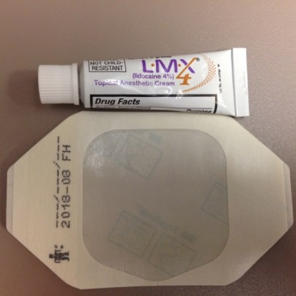
Topical Analgesics
Require some planning to implement
Time
Cost (Taddio et al., 2015; WHO, 2015)
LMX-4®
30 minute onset
Penetrates to muscle
OTC
EMLA®
60 minute onset
Requires prescription
(Mayo Clinic, 2014)
Notes:
How to put it on – difference between EMLA & LMX-4

Slide 20
Topical Analgesic Facts:
Pain ratings were higher during subsequent needle-related procedures when a placebo was used instead of a topical analgesic
(Weisman, Bernstein, & Schechter, 1998)
Topical analgesics are often underutilized by healthcare providers (Jeffs, Scott, & Green, 2011)
Parents are willing to wait and pay for topical analgesics (Walsh & Bartfield, 2006)

Slide 21
Oral Sucrose
Sweet-Ease®
Give 2 minutes prior to any poke or procedure
Absorbed in cheek and sublingually, not swallowed
Utilized opioid pathways
Synergistic with sucking
Pacifier
Gloved finger
http://www.usa.philips.com/healthcare/product/HC989805603401/sweet-ease-natural-15-ml-cup

Slide 22
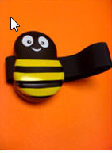
Buzzy® the Vibrating Ice Pack
(Mayo Clinic, 2014)
Gate theory of pain – interrupts pain fibers
Cold and vibration help relieve pain
(Baxter, Cohen, McElvery, Lawson, & von Baeyer, 2011)
Distraction
Children 3 and under may not like the ice – use buzzy only
Placement between “pain and the brain”
https://buzzyhelps.com

Slide 23
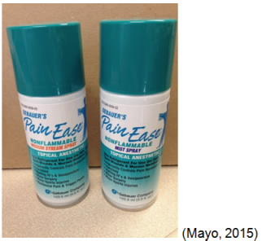
Pain-Ease® Spray
http://www.gebauer.com/painease
Vapocoolant spray that controls pain during injections and minor procedures
Interrupts body’s experience to pain
Works immediately by reducing the skin temperature by 1-3 degrees
Easy to apply & cost effective (multi-use container)
May be reapplied after 1 minute as needed
Notes:
How to apply – up to 10 seconds, skin turns white, complains of cold
Inject within a minute
Stream hurts less than the mist
Spray AFTER the skin is prepped

Slide 24
Comfort Positions and Distraction Techniques

Slide 25
Comfort Positions
A “hug” from a parent or caregiver as an alternative to restraining a child. Nurse or provider stabilizes the limb to be immunized
Allows children to feel
Secure
Reassured
Empowered
Use appropriate comfort position to meet the individual needs of the child

Slide 26
Comfort Positions:
They support family-centered care
They help children cope with medical experiences and teach them skills for future visits
Children become more compliant
They help to enhance a child’s medical experience

Slide 27
Comfort Positions for Infants
They can isolate an extremity for procedure or poke
They allow for active caregiver participation
They decrease stress, not only for the patient, but for caregiver & staff
Mayo Clinic, 2012

Slide 28
Comfort Positions for Pre-School/School Age:
They are non-aggressive & non-threatening
They can eliminate the need to be lying down on the exam bed
control issue for children
scary/vulnerable position to be in
Mayo Clinic, 2012

Slide 29
Distractions:
Poor understanding on part of parents and providers regarding the value of these interventions:
Comfort items (stuffed animals, blanket)
Magic
Play is how children learn (toy medical kit)
Deep breathing (pinwheel, bubbles, party blower)
Child-lead directed distractions (games, music)
Nurse & parent-lead distractions (toys, videos)
(Chambers, Taddio, Uman, McMurtry, & HELPinKIDS Team, 2009)

Slide 30
Other Administration Practices

Slide 31
Tips
Deep breathing (Chambers, Taddio, Uman, McMurtry, & HELPinKIDS Team, 2009)
Be honest – tell what is about to take place and why
Age appropriate language
Use “poke” instead of shot
Use “bed” instead of table
Assess situation then poke
Presence of caregiver to lower stress (WHO, 2015)

Slide 32
Administration Techniques

Slide 33
Procedural Interventions:
*These add little or no time or cost!
No aspiration used during IM injections
Not necessary due to lack of major blood vessels in injection sites
Decreased pain
Inject most painful injection last
Pain escalates with each subsequent poke
Rapid injection (with correct technique)
(Kruger, Sumaya, Pickering, & Atkinson, 2011; Taddio et al., 2015)

Slide 34
Procedural Interventions Continued…
Stroking site close to injection before & during injection
Correct size needle to deliver vaccine to appropriate location for the specific poke
No antipyretics before or at time of vaccine
Sequential vs. simultaneous injections
No proof they are less painful and simultaneous injections are less safe
(Kruger, Sumaya, Pickering, & Atkinson, 2011; Prymula et al., 2009 ; Taddio et al., 2015; Taddio, Ilersich et al. 2009)

Slide 35
Physical Interventions:
Breastfeeding during vaccine injections
Reduces stress via: physical comfort, sucking, distraction, ingesting sweet-tasting milk
Does not negatively impact breastfeeding
Comfort positions
Comfortable and close proximity
Not lying supine during injections & sitting upright (~6 months old)
Not forcibly restraining, which increases fear & the child looses sense of control.
(Taddio et al., 2015; Taddio, Ilersich et al., 2009)

Slide 36
Physical interventions for infant immunizations
5 S’s
Swaddling
Side/stomach position
Shushing
Swinging
Sucking
Decreased pain scores & crying time for 2 & 4-month old infants during routine vaccinations
(Harrington et al., 2012)

Slide 37
Process Interventions
Education of providers administering vaccine injections about pain management
Parents should be present during vaccines
Education of parents about pain management
Education of children three years and older and adults about pain management on the day of vaccination
(Taddio et al., 2015)

Slide 38
Tips to Remember:
Children cannot advocate for themselves or express what they are feeling
They are at risk of developing long-term consequences from unmitigated pain
(Taddio et al,., 2015; WHO, 2015)
There are options available that should be offered to children
Educational efforts are needed for parents & vaccinators to promote interventions during shots (Taddio, Ilersich et al., 2009)

Slide 39
References:
Baxter, A., Cohen, L., McElvery, H., Lawson, M., & von Baeyer, C. (2011). An integration of vibration and cold relieves venipuncture pain in a pediatric emergency department. Pediatric Emergency Care, 27(12), 1151-1156.
Chambers, C. T., Taddio, A., Uman, L. S., McMurtry, M., & HELPinKIDS Team (2009). Psychological interventions for reducing pain and distress during routine childhood immunizations: A systematic review. Clinical Therapeutics, 31(supplement B). S77-103.
Chan, S., Pielak, K., McIntyre, C., Deeter, B., & Taddio, A. (2013). Implementation of a new clinical practice guideline regarding pain management during childhood vaccine injections. Pediatric Child Health, 18(7), 367-372.
Harrington, J. W., Logan, S., Harwell, S., Gardner, J., Swingle, J., McGuire, E., & Santos, R. (2013). Effective analgesia using physical interventions for infant immunizations. Pediatrics, 129(5), 815-822.
Inal, S., & Kelleci, M. (2012). Relief of pain during blood specimen collection in pediatric patients. MCN: The American Journal Of Maternal Child Nursing, 37(5), 339-345. doi:10.1097/NMC.0b013e31825a8aa
Jeffs, D., Wright, C., Scott, A., Kaye, J., Green, A., & Huett, A. (2011). Soft on sticks: An evidence-based practice approach to reduce children’s needle stick pain. Journal of Nursing Care Quality, 26(3), 208-215. doi:101097/NCQ.Ob013e31820e11de
Kruger, A. T., Sumaya, C. V., Pickering, L. K., & Atkinson, W. L. (2011). General recommendations on immunization: Recommendations of the advisory committee on immunization practices (ACIP). Center for Disease Control and prevention. Retrieved from http://www.cdc.gov/mmwr/preview/mmwrhtml/rr6002a1.htm
Prymula, R., Siegrist, C. A., Chlibek, R., Zemlickova, H. Vackova, M., Smetana, J. Lommel, P., Kaliskova, E., Borys, D., Schuerman, L. (2009). Effect of prophylactic paracetamol administration at time of vaccination on febrile reactions and antibody responses in children: two open-label, randomised controlled trials. The Lancet, 374(9698), 1339-1350. Retreived from http://www.thelancet.com/journals/lancet/article/PIIS0140-6736%2809%2961208-3/abstract

Slide 40
References continued…
Mayo Foundation for Medical Education and Research. Comfort Positions, Mayo Clinic (2012).
Taddio, A., Chambers, C. T., Halperin, S. A., Ipp, M., Lockett, D., Rieder, M., & Shah, V. (2009). Inadequate pain management during routine childhood immunizations: The nerve of It. Clinical Therapeutics, 31(supplement B), S152-167.
Taddio, A., Ilersich, A. L., Ipp, M., Kikuta, A., Shah, V, & HELPinKIDS Team (2009). Physical interventions and injection techniques for reducing injection pain during routine childhood immunizations: Systematic review of randomized controlled trials and quasi-randomized controlled trials. Clinical Therapeutics, 31(Supplement B), S48-76.
Taddio, A., McMurty, M., Shah, V., Riddell, R., Chambers, C., Noel, . . . HELPinKids & Adults (2015). Reducing pain during vaccine injections: Clinical practice guidelines. Canadian Medical Association Journal, 187(13), 975-982. http://www.guideline.gov/content.aspx?f=rss&id=49938&osrc=12#Section434
Walsh, B. M. & Bartfield, J. M. (2006). Survey of parental willingness to pay and willingness to stay for “painless” intravascular catheter placement. Pediatric Emergency Care, 22(11). Pg. 699-703.
Weisman, S. J., Bernstein, B., & Schechter, N. L. (1998). Consequences of inadequate analgesia during painful procedures in children. Pediatric Adolescent Medicine, 152, 147-149.
Wong, D. L., & Baker, C. M. (1988). Pain in children: Comparison of assessment scales. Pediatric Nursing, 14, 9-17.
World Health Organization (WHO) (2015). Reducing pain at the time of vaccination: WHO position paper – September 2015. Weekly epidemioloigical record, 39(90), 505-516. Retrieved from http://www.who.int/wer/2015/wer9039.pdf?ua=1

