Slide 1
Making the Most out of MIIC
SEMIC 2017 Spring Immunization Conference
Jennifer Brickley, RN

Slide 2
Objectives
Understand basic information that MIIC provides as a resource for immunization records
Describe the different prompts and uses of the forecaster tool
Anticipate common issues with current MIIC forecasting to avoid extra-immunization

Slide 3
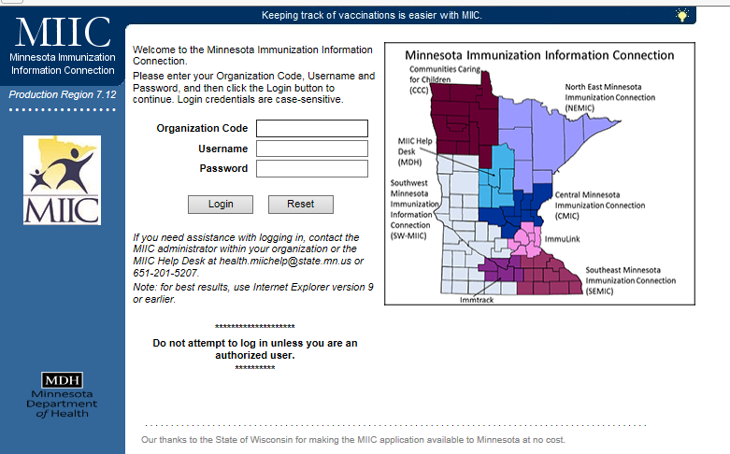
Minnesota Immunization Information Connection (MIIC)
The Minnesota Immunization Information Connection (MIIC) is a system that stores electronic immunization records. MIIC makes keeping track of vaccinations easier and helps ensure Minnesotans get the right vaccines at the right time.

Slide 4
How to Use MIIC
View vaccines given in Minnesota
View vaccines given to persons who have a Minnesota address but were vaccinated in Wisconsin
Plan for future vaccines with the Clinical Decision Support Tool - “forecaster”
Find contact information to clarify vaccines given elsewhere
Order and manage vaccines

Slide 5
Advanced Uses for MIIC
Access immunization rates
Run reports for your institution
Conduct reminder/recall programs
Use data for quality improvement

Slide 6
HepA Reporting
MIIC report based on 2 doses by 24 mo
ACIP recommends initiating two-dose series at 12-23 mo, separating doses by 6-18 mo
HEDIS and Minnesota Community Measures have changed their requirements to 1 dose by 24 mo
If your institution gives the second HepA at 24 mo, your results may be different than other immunization measures (internal or external)
Notes:
https://www.cdc.gov/vaccines/schedules/downloads/child/0-18yrs-child-combined-schedule.pdf; schedule graph says 12-18, but footnotes state wording above
HEDIS recognized and changed, MDH noted increase in errors when the vaccine was given at 12 and 18 mo as minimal intervals were being violated.

Slide 7
User Groups
Child Care
Colleges & Universities
Community Vaccinators
Health Plans
Hospitals
Local Public Health
Long Term Care/Home Health
MN Department of Health
Occupational Health
Pharmacies
Primary Care
Retail/Convenience Clinics
Schools
Specialty Clinics
Urgent Care
Notes:
http://www.health.state.mn.us/divs/idepc/immunize/registry/infographic.pdf

Slide 8
User Levels
Organization or individual log-on
Different user levels
All access
Regional Coordinators, MDH staff
Editing privileges
Public Health, Administration, IT
Viewer only privileges
School nurses and most clinic staff
Notes:
Some examples, not inclusive or definitive
Less staff able to edit = better quality of data
Staff who have experience with vaccines or someone who can be taught. Wrong vaccine dose or naming (Tdap vs. DTaP) makes a difference

Slide 9
Logging on to MIIC
Organizations will provide a link if one log-in code is given for all users
If your organization has not yet entered immunizations for a patient, it may appear that there is no client

Slide 10
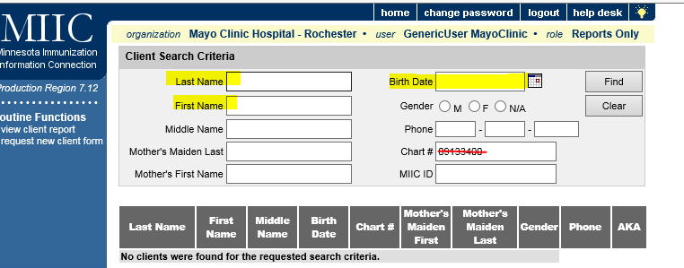
Finding your Patient
Delete chart number
Enter last name, first name, and DOB
Notes:
If you have an individual log-in, you will most likely be typing this information already
If the patient has already been vaccinated at your institution, it will automatically go to the patient (skip this step)

Slide 11
Client “AKAs”
Some names will have “AKA” beside them
This means the client is known in MIIC by more than one identifier
No matter which name you click on, they will all link to one vaccination record
Notes:
Anytime record has been edited; wrong birthdate originally entered, patient is now married

Slide 12
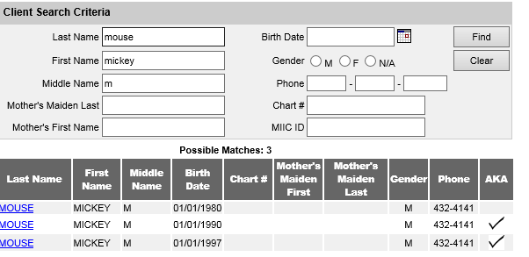
AKA Example

Slide 13
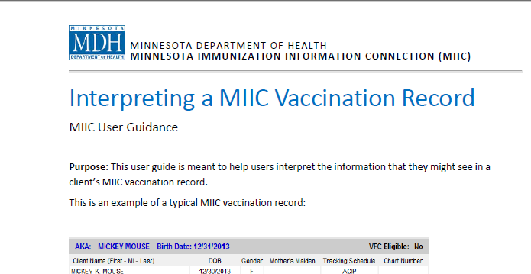
MDH Has a Great PDF on Basics
http://www.health.state.mn.us/divs/idepc/immunize/registry/hp/interpret.pdf

Slide 14
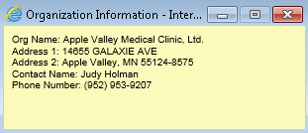
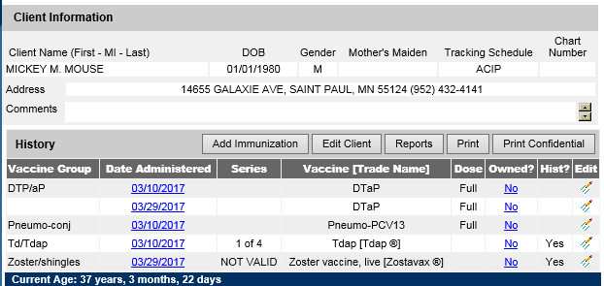
MIIC Basics
Notes:
http://www.health.state.mn.us/divs/idepc/immunize/registry/hp/interpret.pdf

Slide 15
Vaccine History
Patient identifiers
Vaccines given
Vaccine place in series
Vaccine validation
Ownership - who gave it
If states, “no” – click on “no” to see who gave the vaccine
Editing function (not all users see this)

Slide 16
MIIC as a Tool
MIIC provides guidance for future vaccines through the forecasting tool
No tool is 100% correct 100% of the time
Just like any electronic tool, it may be necessary to use it in conjunction with other tools to provide immunization guidance
Even the ACIP schedule is usually published only once a year!

Slide 17
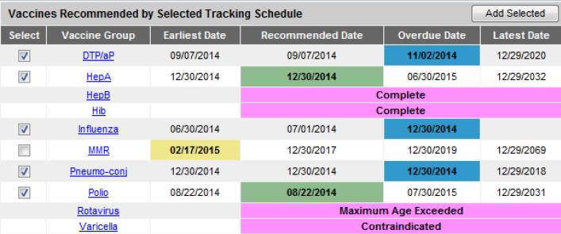
Clinical Decision Support Tool

Slide 18
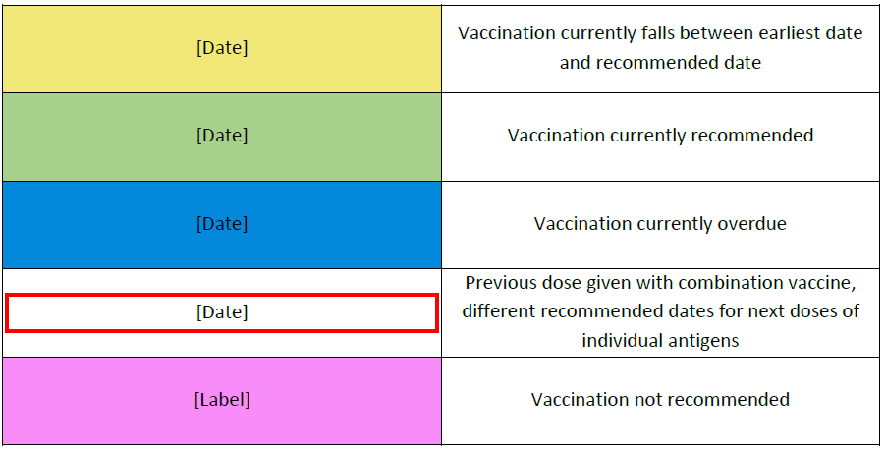
What do the Colors Mean?
Notes:
No examples of red box

Slide 19
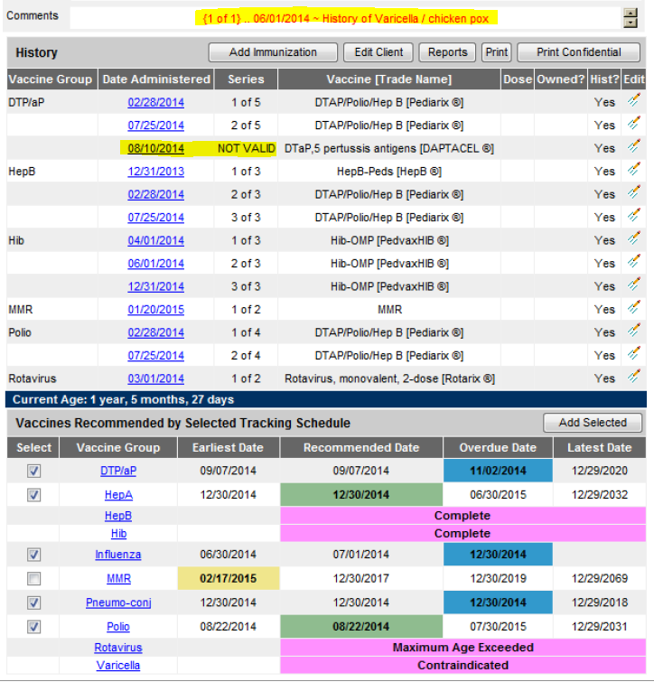
Notes:
DOB: 12/30/2013; start with DTaP blue overdue; discuss non-validity and explanation, 28 days/28 days/2 months/right before patient turns 7)
HepA: Green recommended (falls within standard recommendations), not given yet, due/due/by 18 mo/right before patient turns 19 (chg to adult dose)
HepB: Pink “Vaccine not recommended” Complete, proper spacing, age and number of doses
MMR: Yellow: Earliest date; minimum spacing/recommended date (4-6 years)/end of recommended years-6/adult schedule through 59 y
Pneumococcal: note age out at 5 years
Rotavirus: Pink “Vaccine not recommended” https://www.cdc.gov/mmwr/preview/mmwrhtml/rr5802a1.htm ACIP allows series to be completed if inadvertently started.
Varicella: Contraindicated due to immunity; standard terminology
Not valid (click on and will get info box)

Slide 20
Information on Why Dose is Not Valid

Slide 21
When Vaccines are Not Valid
Most marked as not valid are due to:
Vaccination was given before or after the recommended age
Vaccination was given too close to another dose in the series (interval between doses is too short)
Vaccination was a live vaccine and was given too close to another live vaccine (closer than 28 days)

Slide 22
Special Not Valid Situation
An extra dose of vaccine when given as part of a combination
DOB 4/21/2009
Dose okay, but IPV not valid because 4th dose needs to be after age 4 years
Only marked under the polio section
Forecaster recommends correct future date
Notes:
Sometimes causes confusion, people think the whole combination vaccine is not valid

Slide 23
Other Situations
Some may have no information if they are part of an allowed extra dose due to combination vaccine
Polio as given with Pentacel once minimum age met

Slide 24
Known Issues
HPV
MDH is currently working on fixing HPV forecaster issues
Correct if patient starts 3-dose series at 15 or older and is appropriately spaced
Notes:
3 dose rule: minimum 12 weeks from 2nd dose and 5 months from first dose
DOB 12/30/1993

Slide 25
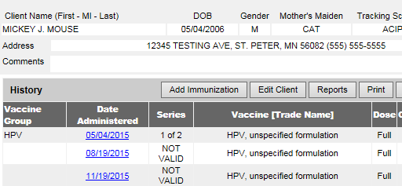
HPV Issue Scenario #1
Valid series appears not valid
Invalidates both 2nd and 3rd doses
Notes:
3 dose rule: minimum 12 weeks from 2nd dose and 5 months from first dose
#2 not valid here because not 5 months from first dose (incorrect)
#3 not valid here because not 5 months from second dose (incorrect)

Slide 26
HPV Issue Scenario #2
MIIC validates 3rd dose but not 2nd dose; series complete
Notes:
Technically this is a valid three dose series

Slide 27
HPV Issue Scenario #3
This language can seem confusing
Patient is less than 15 years
Started before two-dose rule applied
Second dose given before new recs implemented
Notes:
Valid in the three dose series, which was what this patient was on at the time.

Slide 28
Use Other Tools!
If you are questioning, look at other tools
For example - HPV issues:
ACIP recommendations and new schedule
Minnesota Department of Health web site
Table
Algorithm
Consult your MIIC contact at your institution
Contact your regional coordinator
Contact MIIC through the web
Notes:
Use other tools to avoid extra immunizations

Slide 29
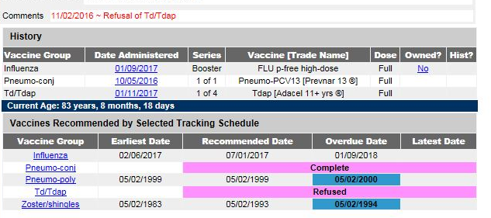
Series Issues
Tetanus/Diphtheria series
1 of 4 problematic
Notes:
Predicting they need a primary series AND a Tdap over the age of 11. No primary series documented. This patient could be up to date, but without records, it will prompt a primary series if seven years or older (correct!). Should get copies of primary series records.
Some people, depending on age and a partial series need four, but previously unvaccinated patients age 7 or older need 3 spaced 0, 1, 7. One needs to be Tdap. This number will often change when the patient has had the three doses completed.
Use other tools

Slide 30
Deferrals and the Forecaster
If a vaccine is deferred, the forecaster no longer predicts next vaccines due – states “Refused”
Always continue to offer – use other tools
Notes:
Td/Tdap scenario given brings up other issue-
ACIP recommends offering vaccines at every visit, even if they have been previously deferred
Real problem for infants, especially if they are behind in immunizations or were just ill at their well child visit
So again, use other tools!

Slide 31
What You Enter Matters
Any vaccine information entered from an electronic medical record is considered valid information
Oral report of historical vaccines
Influenza only!
Pneumococcal cannot count any more
Do not enter patient provided historical information without a valid, written record
Vaccine with correct abbreviation or name
Valid date
Notes:
ACIP recommendations ref: https://www.cdc.gov/mmwr/preview/mmwrhtml/rr6002a1.htm

Slide 32
Incomplete Written Records
Non-specific information that should be clarified before entering historically
DTaP/DTP/DT 04/06/1971
Td/Tdap 05/27/2005
Pneumococcal 09/03/2003
Meningococcal 09/03/2003

Slide 33
Improbable Shots
Report that can be run showing immunizations that were most likely documented incorrectly
DTaP vaccines given to older adults
PPSV23 given to an infant
Should do investigation and follow-up to track the root of the problem
Notes:
Is it a person with no experience in vaccines entering data?
Is your practice giving the wrong vaccine?

Slide 34
Last Tips
Don’t make assumptions about patients based on comments in MIIC
Coding is designed by institutions that send data
A “refusal” could just be that they were ill
A “refusal” may be been an immunity status that transferred as a deferral

Slide 35
Summary
MIIC is a great tool and has many uses
Utilize MIIC resources to understand functionality including forecasting
Use it like other resources - may need more than one resource for forecasting
Anticipate common issues with current MIIC forecasting to avoid extra-immunization
Contact your resources if you have questions

Slide 36
Resources
Minnesota Department of Health MIIC
MIIC record requests
Information for the public and providers
Statistics and reports
Privacy Information
Contact information
Southeastern Minnesota Regional Coordinator
Brian Moehnke
brian@semnic.org
507-282-1772

